Slide 1


Fake News Prediction

Slide 2
Table of Contents
Problem Statement
Project Aim
Model training and evaluation
Model Deployment Using Flask
User Experience Interface
AWS Architecture
Future Work

Slide 3
Problem Statement:
Fake news is a major concern in today's world, as it spreads false information through social media, leading to misinformation, confusion, and harm. Developing systems to identify and prevent fake news is crucial.
Project Aim:
This project aims to create a fake US news prediction web application that accurately classifies news articles as fake or not fake. It will be trained on a labeled dataset using machine learning techniques and deployed as a web application using Flask in AWS servers.

Slide 4
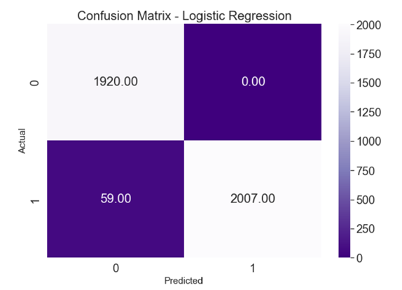
Model training and evaluation
Average cross-validation score
0.983
TP / TN
Logistic Regression
TN → 1920
TP → 2007
FP / FN
FP → 0
FN → 59

Slide 5
Model Deployment Using Flask
The trained Logistic Regression model is deployed using Flask, a lightweight Python web framework.
The deployment consists of three main components:
-app.py: Python script implementing the model, data pre-processing, feature extraction, and Flask app route definitions.
- input_news.html: User interface for submitting news articles for evaluation.
- results.html: Displays prediction results, indicating fake or not fake classification.

Slide 6
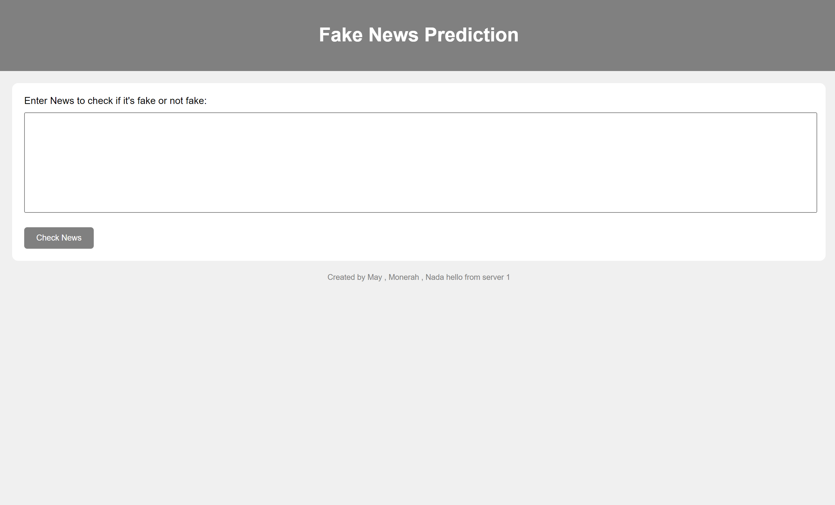
User Experience Interface

Slide 7
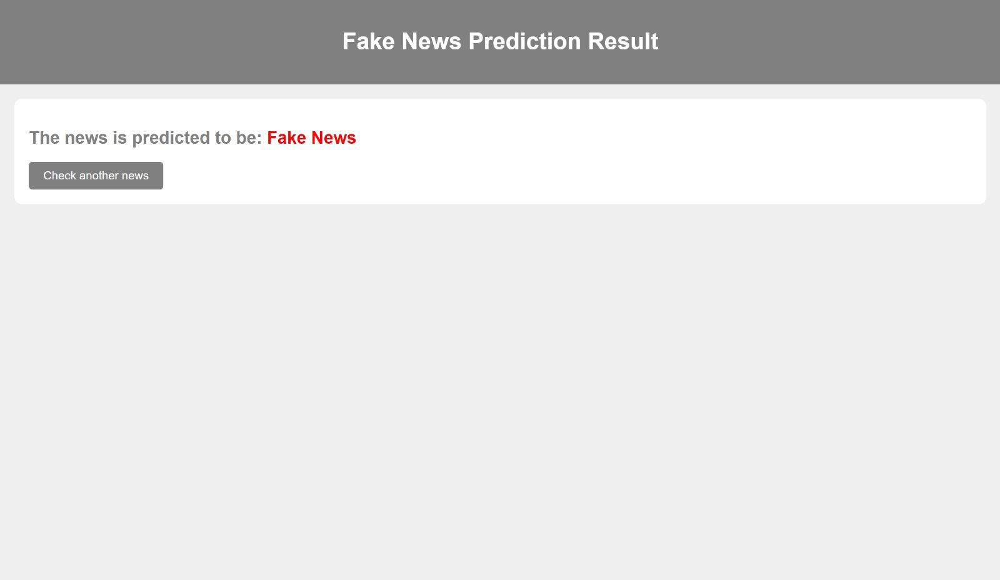
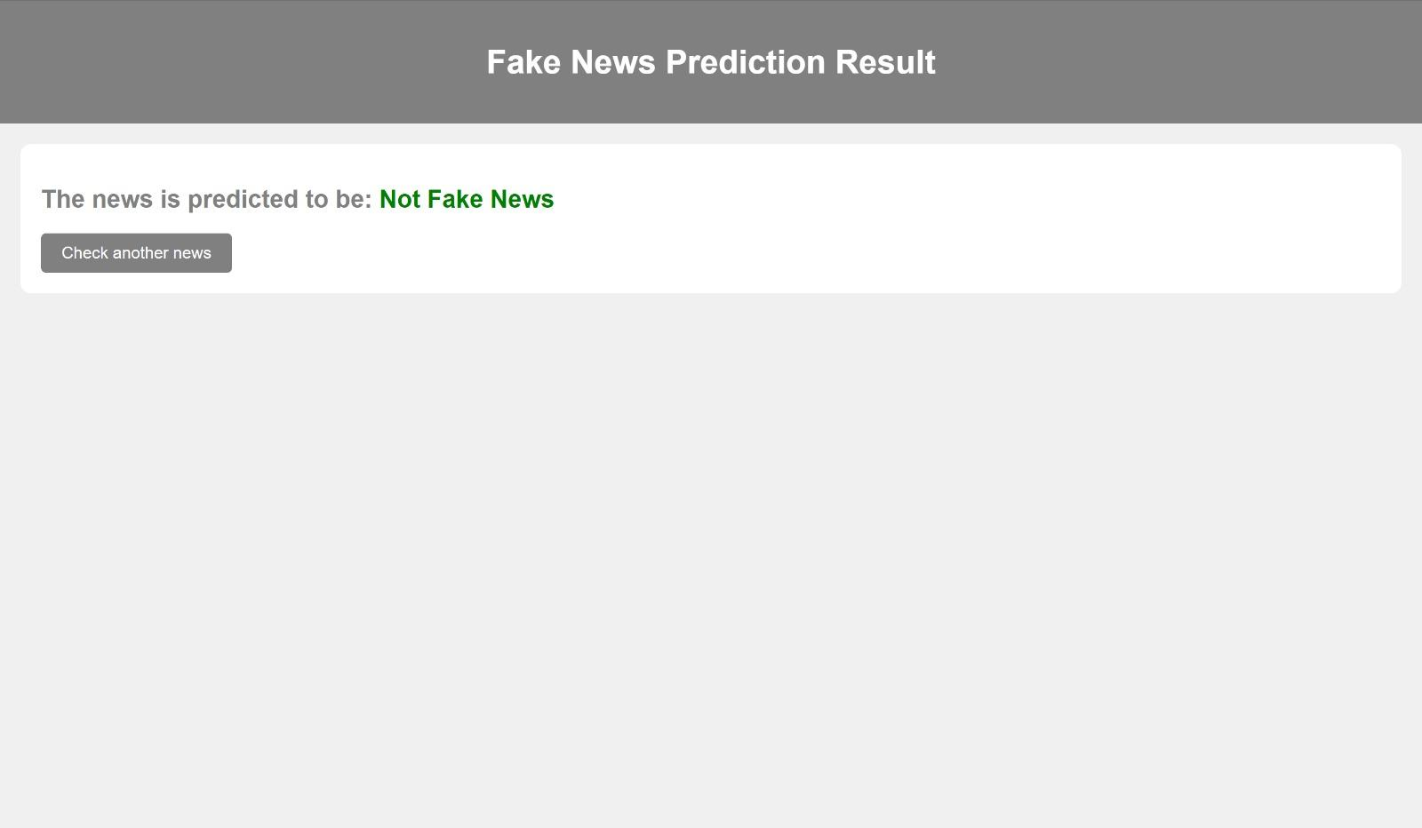
User Experience Interface

Slide 8
User Experience Interface

Slide 9

Check this

Slide 10
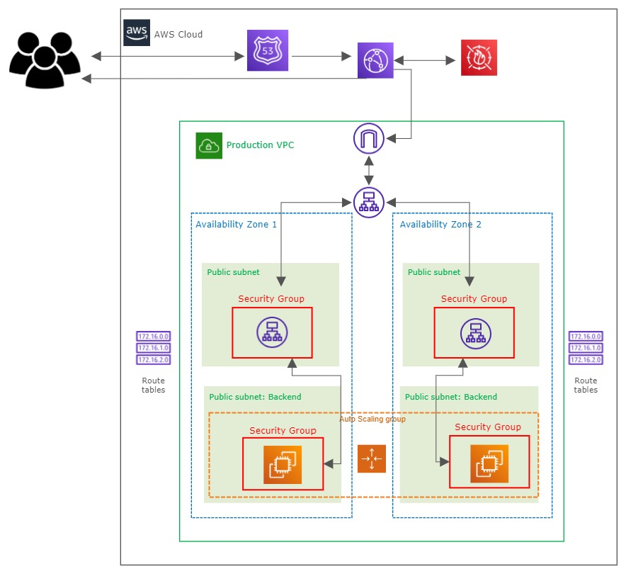
AWS Architecture :

Slide 11
Future work plan
- Fitch KSA news from various resources.
- More data preprocessing techniques.
- Use AWS ECS container servers.

Slide 12
Examples to run
Fake: MEDIA COULDNâ€™T BE FOUND DURING BENGHAZI SCANDALâ€¦But Watch Them Sprint After Hillaryâ€™s â€œScoobyâ€ Van To Catch Her First Campaign Stop Not that anyone should be surprised by the lap dog mentality of these second rate liberal hack journalists. They re the reason the most crooked woman in America is even a contender in this race. Government News 14-Apr-15
Not fake:Russia says North Korea's latest missile launch flouted U.N. resolutions: Ifax MOSCOW (Reuters) - The Russian Foreign Ministry said on Friday that North Korea s latest missile test violated United Nations Security Council resolutions, the Interfax news agency reported. Moscow called on all sides to show restraint, Interfax quoted Maria Zakharova, the foreign ministry s spokeswoman, as saying. Pyongyang fired a missile that flew over Japan s northern Hokkaido far out into the Pacific Ocean on Friday, deepening tension after its recent test of its most powerful nuclear bomb. worldnews 15-Sep-17

Slide 13
Thanks !
Do you have any questions?
Monerah Alomobarak
Nada Alotaibi
May AlSohibani

